Slide 1


Computer Graphics
Lecture 11,12
Filling Area

Slide 2

Polygon Representation
The polygon can be represented by listing its n vertices in an ordered list.
P = {(x₁, y₁), (x₂, y₂), ……., (x_{n}, y_{n})}.
The polygon can be displayed by drawing a line between (x₁, y₁), and (x₂, y₂), then a line between (x₂, y₂), and (x₃, y₃), and so on until the end vertex. In order to close up the polygon, a line between (x_{n}, y_{n}), and (x₁, y₁) must be drawn.
One problem with this representation is that if we wish to translate the polygon, it is necessary to apply the translation transformation to each vertex in order to obtain the translated polygon. 2

Slide 3
Polygon Types
Polygons can be divided into three basic types: convex, concave, and complex.

Slide 4

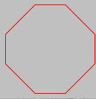
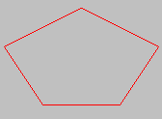
Convex
Does a straight line connecting ANY two points that are
inside the polygon intersect any edges of the polygon?

Slide 5


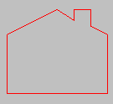
Concave
The polygon edges may also touch each other, but they may not cross one another.

Slide 6

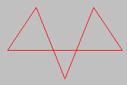
Complex
Complex polygons are basically concave polygons that may have self-intersecting edges. The complexity arises while distinguishing which side is inside the polygon when filling it.

Slide 7
Polygon Filling
What is Polygon filling?
➔ Highlight all the pixels in the polygon with any color other than the background.
Types of Polygon filling ( 2 approaches)
Seed Fill:
Boundary Filling:
Flood Filling: Select interior point - Paint outwards
Scan-line : Scan lines between Boundaries and color the pixels that lies inside the polygon.

Slide 8

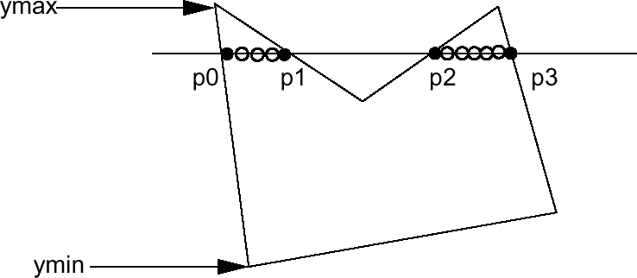
Scanline Fill Algorithm
Intersect scanline with polygon edges
Fill between pairs of intersections
Basic algorithm:
For y = ymin to ymax
intersect scanline y with each edge
sort intersections by increasing x [p0,p1,p2,p3]
fill pairwise (p0->p1, p2->p3, …)
11

Slide 9
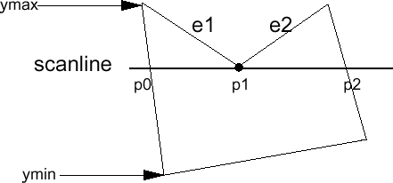
Spacial Handling (cont.)
Intersection is an edge end point
Case 1
Intersection points: (p0, p1, p2) ???
->(p0,p1,p1,p2) so we can still fill pairwise
->In fact, if we compute the intersection of the scanline with edge e1 and e2 separately, we will get the intersection point p1 twice. Keep both of the p1.
168 471 Computer Graphics, KKU. Lecture 7
12

Slide 10
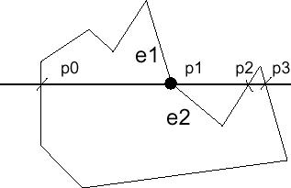
Spacial Handling (cont.)
Case 2
However, in this case we don’t want to count p1 twice (p0,p1,p1,p2,p3), otherwise we will fill pixels between p1 and p2, which is wrong.
13

Slide 11
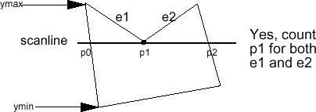
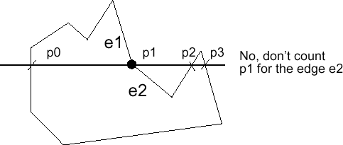
Spacial Handling (cont.)
Summary: If the intersection is the ymin of the edge’s endpoint, count it. Otherwise, don’t.
Both edges are in the same side of the scan line
Both edges are in the opposite side of the scan line
Fix a new start point for e2
14

Slide 12

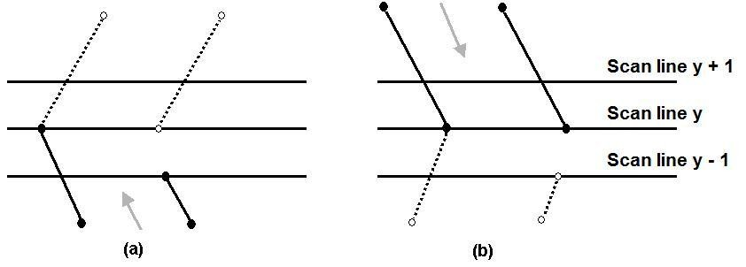
The Scan-Line Polygon Fill Algorithm
Dealing with vertices
When the endpoint y coordinates of the two edges are monotonously increasing, the y value of the upper endpoint for the current edge is decreased by one (a)
When the endpoint y values are monotonously decreasing, the y value of the next edge is decreased by one (b)

Slide 13

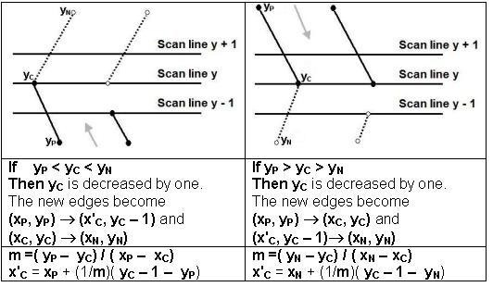
The Scan-Line Polygon Fill Algorithm
(Example)
N.B. x2=x1+1/m(y2-y1)

Slide 14

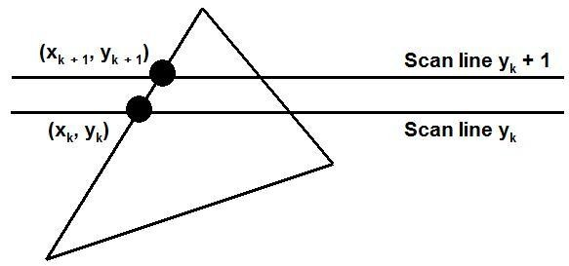
The Scan-Line Polygon Fill Algorithm
Determining Edge Intersections
m = (y_{k+1} – y_{k}) / (x_{k+1} – x_{k}) y_{k+1} – y_{k} = 1
x_{k+1} = x_{k} + 1/m

Slide 15

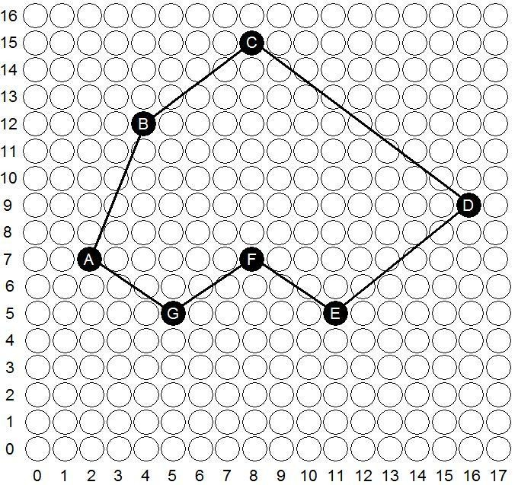
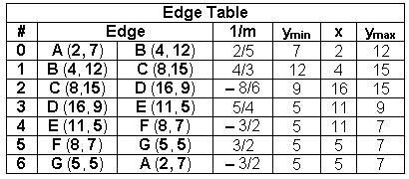
The Scan-Line Polygon Fill Algorithm
(Example) Polygon = {A, B, C, D, E, F, G}
Polygon = {(2, 7), (4, 12), (8,15), (16, 9), (11, 5), (8, 7), (5, 5)}

Slide 16

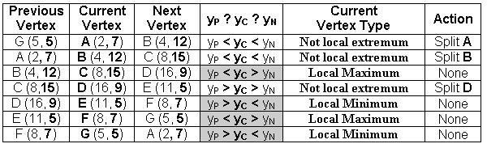
The Scan-Line Polygon Fill Algorithm
(Example)
Vertex A should be split into two vertices A' (x_{A'}, 6) and
A(2, 7)
m =( 5 – 7)/( 5 – 2) = – 2/3
x'_{A} = 5 + (–3/2)( 7 – 1 – 5) = 7/2 = 3.5 ≅ 4
The vertex A is split to A' (4, 6) and A(2, 7)

Slide 17
The Scan-Line Polygon Fill Algorithm
(Example)
Vertex B should be split into two vertices B' (x_{B'}, 11) and
B(4, 12)
m =( 7 – 12)/( 2 – 4) = 5/2
x'_{A} = 2 + (2/5)( 12 – 1 – 7) = 18/5 = 3.6 ≅ 4
The vertex B is split to B' (4, 11) and B(4, 12)

Slide 18
The Scan-Line Polygon Fill Algorithm
(Example)
Vertex D should be split into two vertices D(16, 9) and D'
(x_{D'}, 8)
m =( 5 – 9)/( 11 – 16) = 4/5
x'_{D} = 11 + (5/4)( 9 – 1 – 5) = 59/4 = 14.75 ≅ 15
The vertex D is split to D(16, 9) and D' (15, 8)

Slide 19
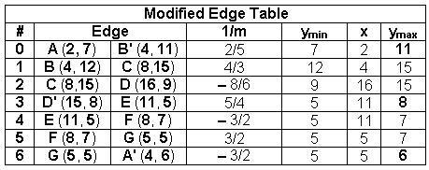
The Scan-Line Polygon Fill Algorithm
(Example)

Slide 20

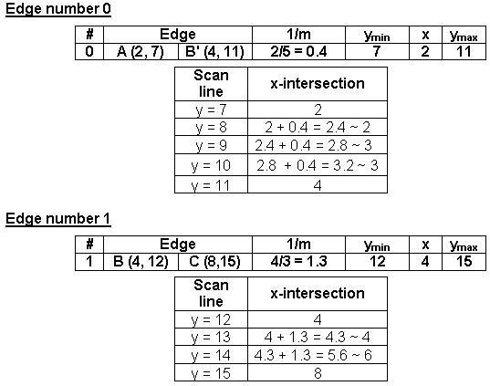
The Scan-Line Polygon Fill Algorithm
(Example)

Slide 21
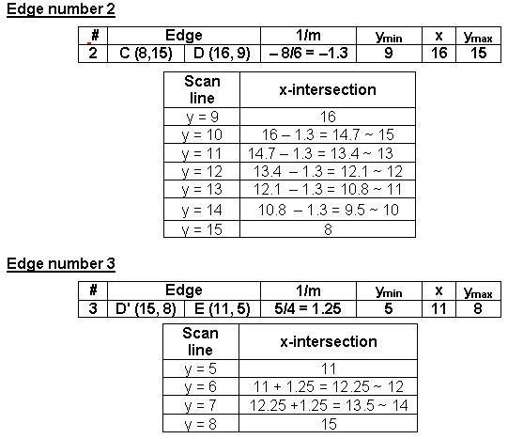
The Scan-Line Polygon Fill Algorithm
(Example)

Slide 22
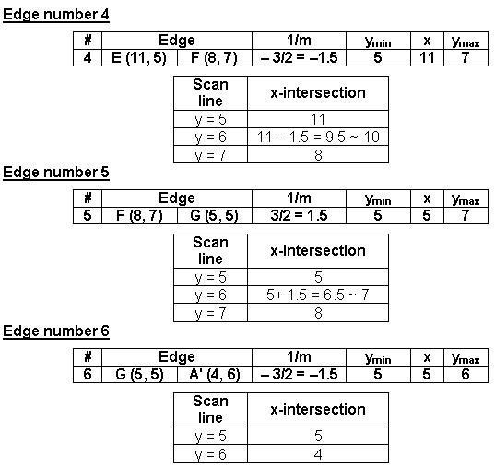
The Scan-Line Polygon Fill Algorithm
(Example)

Slide 23
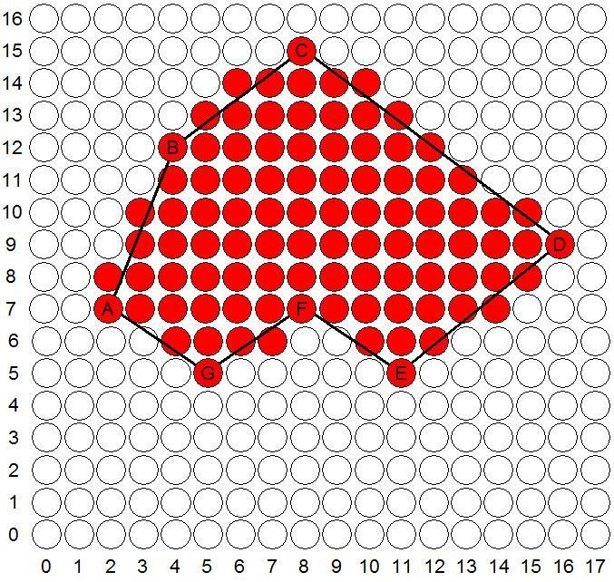
The Scan-Line Polygon Fill Algorithm
(Example)

Slide 24
The End

